Slide 1
Web Services Integration
SE495: Software and Systems Integration

Slide 2
Outline
Web Services
Integration/Composition
Application Integration and Event Streaming
Camel and Kafka

Slide 3
Web Services

Slide 4
Web Service (WS)
Web Services are building blocks of SOC software
SOAP/WSDL services have an standard interface in WSDL
RESTful services use HTTP without using SOAP/WSDL
WS can be remotely invoked via a message in a standard protocol, e.g., SOAP, HTTP – It is NOT a remote procedure call
Loosely coupled vs. tightly coupled
Data flow vs. control flow
Web Services are platform-independent, it can be written in any languages: Java, C#, C++, Python, etc.
Every piece of program can be wrapped into a WS
Every WS can be placed in an internet-searchable repository
In the near future, most services required will be available (not necessarily free). There is less need of writing new services. However, there is always a need of writing better services.

Slide 5
Main Web Service Authoring Tools (1)
C# Web Services on Visual Studio
Choose a Web Service templates, WCF, WF, etc.
Define an ordinary class with data members and mainly methods in C#;
Choose methods to be remotable by adding [operation contract]
Compile and run the class, service will be generated;
WSDL file and/or URL of the Web service will be generated;
SOAP/HTTP call interface will be generated;
There is little difference with writing a C# class

Slide 6
Main Web Service Authoring Tools (2)
Java Web Services
Define an ordinary class with data members and methods in Java;
There are different ways to wrap a Java class into a Web service (generate WSDL and SOAP files)
NetBeans, Download: https://netbeans.org/
Eclipse with WS extension,
Java EE,
Community projects and third parties, e.g., Apache Tomcat tool,
IBM tools such WebSphere, http://www.eclipse.org/webtools/initial-contribution/IBM/evalGuides/WebServicesToolsEval.html
JDeveloper / Oracle SOA Suite
Manually write host and extract the required information and wrap them into WSDL and SOAP syntax

Slide 7
Main Web Service Authoring Tools (3)
Python Web Services
There are different environments for defining Python Web RESTful services
Flask
Django
FasrAPI
CherryPy
Pyramid
Visual Studio + Flask: https://docs.microsoft.com/en-us/visualstudio/ide/quickstart-python?view=vs-2022
Visual Studio + Django https://docs.microsoft.com/en-us/visualstudio/python/learn-django-in-visual-studio-step-01-project-and-solution?view=vs-2022
Grok
TurboGears
Web2Py
Bottle

Slide 8
Web Services are Wrapped Classes/Objects
Return value in XML/SOAP/HTTP
To UDDI server
Service
requester
Remote invocation in
XML/SOAP/HTTP
WSDL Description for UDDI publication
RESTful
Reactor
Web service interfaces in WSDL
Automatically
generate the
Service interfaces
Function call
Return value
Service agent
Functions/Methods written in C# / Java / Python
Manually write the functions/methods in the classes in C# or in Java, each function corresponds to a service

Slide 9
Service Broker: Registry and Repository
White pages
Yellow pages
Service brokers
Green pages
Registry
Found
Internet
Publishing
Find
Application builder
Service providers
SOAP call
Applications
Web Services
Results

Slide 10
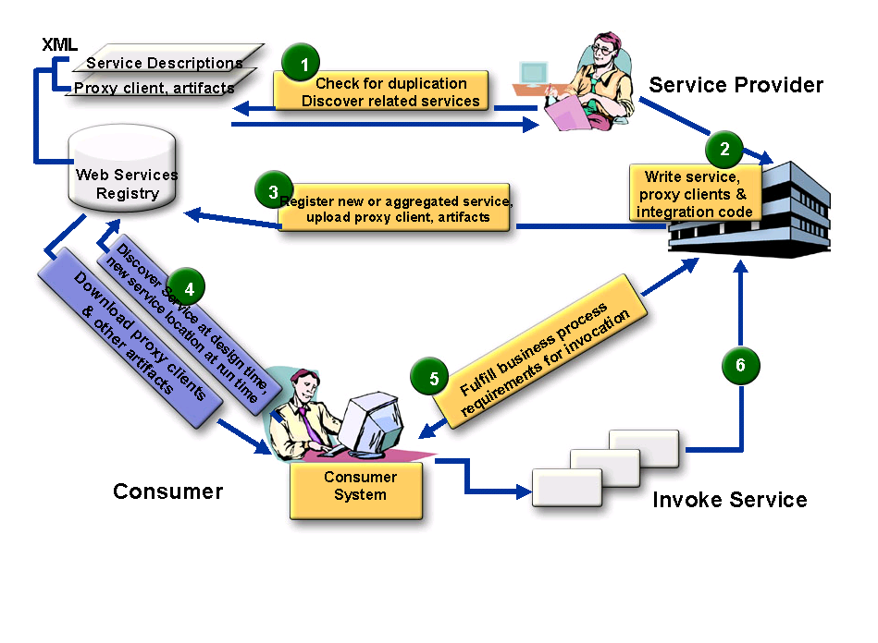

SOA Three Party Model with More Detail
Service Broker
5
4
Define policies: visibility, access, lifecyle stage, etc.
Application
builder
Service Administrator
Service Consumer
Application Builder
End user

Slide 11
Different Kinds of Service Brokers
Service
Brokers
OASIS Standard
UDDI Registry
Limited
automation
OASIS Standard
ebXML Integrated Registry/Repository
Extensive
automation
Ad Hoc
Registry / List
Quick start
Manual
search
Large IT companies
MS, IBM, SAP, HP
Small / Medium IT
Non IT (Boeing)
Government
Small companies
www.programmableweb.com/
ASU Repository
Your Project 3

Slide 12
Who is OASIS?
OASIS is a member-led, international non-profit standards consortium;
Founded under the name "SGML Open" in 1993.
Thousands of individual and organizational members in 100 countries;
The largest standards group for SOA and Web services. Most SOA standards are from OASIS
Supports over 60 technical committees producing royalty-free and RAND (Reasonable and non-discriminatory) licensing in an open process.

Slide 13
UDDI Service Registry, Universal Description, Discovery, and Integration
UDDI registry information is organized in three groups:
White pages include service provider's name, identify, e.g., the DUNS number, contact information.
Yellow pages include industry type, product and service type, and geographical location.
Green pages include five data structures and APIs for allowing computer programs to read and write (register) UDDI registry.

Slide 14
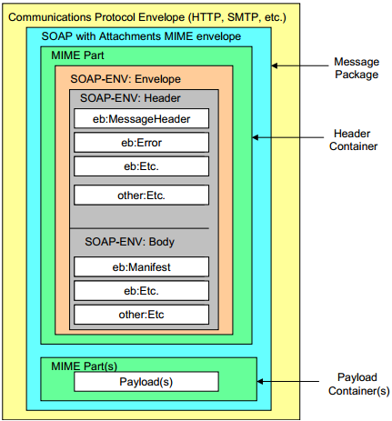
ebXML Consists of Five Modules
http://www.ebxml.org/
Similar to BPEL and Workflow Foundation
Business Process Specification Schema
Core Components
Collaboration Protocol Profiles and Agreements (CPPA)
Message Service https://www.oasis-open.org/committees/ebxml-msg/documents/ebMS_v2_0.pdf
Registry & Repository
ebXML Message
Format

Slide 15
ebXML Vendor Products
Sun Microsystems Inc.
ebXMLsoft Inc.
CHECKMi
Digital Artefacts Inc.
Adobe Systems Inc.
freebXML Registry (open source)
Infravio - X-registry
Xenos Group Inc. – GoXML Registry
Widely used in healthcare systems and government systems

Slide 16
What is ebXML?
An SOA registry as well as a repository
Classification of any type of information
Managing relationships between information
Taxonomy hosting, browsing and validation
File/folder organization of information
A content management system for secure & federated information
Provides services for sharing content and metadata between entities in a federated environment
Lifecycle Management (LCM) actions logged in an audit trail
Supports automatic versioning of objects

Slide 17

ebXML Registry Key Features
Registration, Discovery, Queries
ebXML Registry
Federated Queries, Inter-registry links
Registry
Repository
Taxonomies, Classifications, Associations
Federated Information Manage- ment
Standard Metadata
Secure Architecture
Content management
Cataloging, Content Validation, Version Control, Lifecycle Support, Extensible Information Model
Digital Signatures, Audit Trail, Access Control, SAML Single Sign-On
Events
Content-Based Event Notification

Slide 18
Need for an Integrated SOA Registry/Repository
Governance enforced where SOA artifacts are stored
Registry is not enough – need repository
Repository stores the actual artifacts
Registry stores metadata about the artifacts
An integrated registry/repository ensures consistent storage, management, and reuse of artifacts according to organizational policies
ebXML registry provides an integrated registry/repository
Empower service providers without their own servers

Slide 19
Federated Information Management
Multiple ebXML registries may be federated together to
appear as a single virtual registry/repository
support seamless information integration and sharing
allow local autonomy over data
ebXML federated registry relies on SAML (Security Assertion Markup Language) – the federated identity management standard

Slide 20
Case Study: Government of Canada/Ontario
Vision: Improve service quality to Canadian people and businesses through cost-effective eServices at all levels of government
Target: Leverage the power of XML to deliver those services via collaboration across jurisdictions
Strategy: Enable service delivery infrastructure by utilizing a federated registry and repository

Slide 21

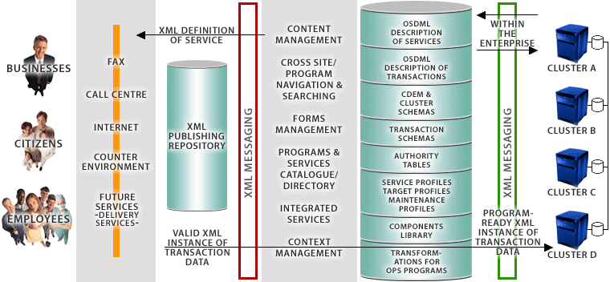




Government of Canada’s Registry/Repository enables Four-Tier e-Government Architecture
ebXML Registry/ Repository
End Users
eContact
CSDML
CBSC
META DATA
CALL CENTRE
CLUSTER SCHEMAS
PORTAL
CSPN
TRANSACTION SCHEMAS
COUNTER ENVIRONMENT
SECURITY
CPSIN
FUTURE SERVICES
- DELIVERY SERVICES -
GSRM Models
BizPal
COMMON COMPONENTS
TRANSFORMATIONS FOR PS PROGRAMS
Presentation Layer
Application Layer
XML Integration Layer
Back-End Layer
Source: Government of Canada

Slide 22
HTTPS Access to ASU Repository
HTTPS: HTTP with SSL (Secure Sockets Layer)
Starting from 2022, ASU requires all accesses to ASU servers to use HTTPS, instead of HTTP.
When you develop a Web application to invoke WSDL web services in ASU Repository, you must use https.
You can open the Web.config file of your Web application and change all http to https and http bindings to https bindings

Slide 23
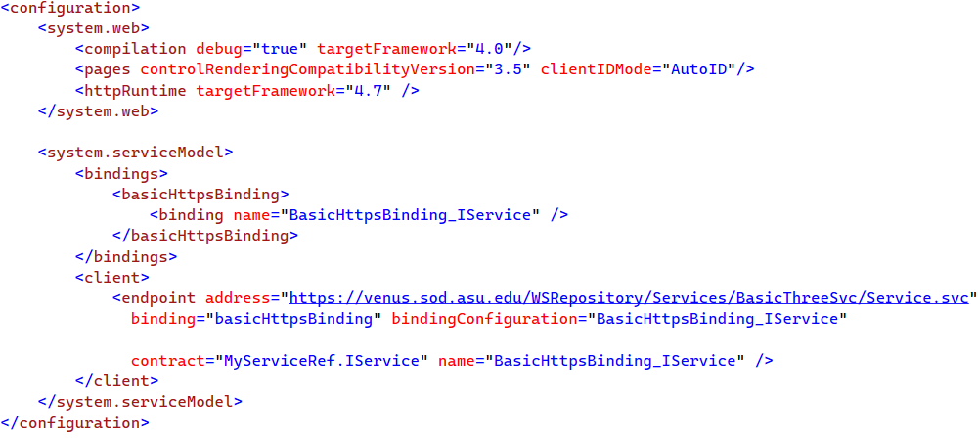
Example

Slide 24
Application Building
Service brokers
Registry
Registry
Application builder
Service providers
Applications
Web Services

Slide 25
Process of Application Building in SOA Style Architecture-Drive Approach
Oracle SOA Suite
Visual Studio WF
Architecture / Component Interface
Level Specification
IBM WebSphere SCA / SDO
IBM WSFL’s Global Model
CSE446 (Integration)
IBM WSFL’s Flow Model
Process / Workflow Level Specification
Microsoft XLANG
BPEL
OWL-S
Code-Level (C#, Java) Assembling and Binding of Components
WSDL
SOAP
CSE445 (Development)
HTTP / RESTful
Deployment
Remote Desktop
FTP / WebDev
Management
IDE (e.g., ebXML, VS)
IDE (e.g., ebXML, VS)

Slide 26
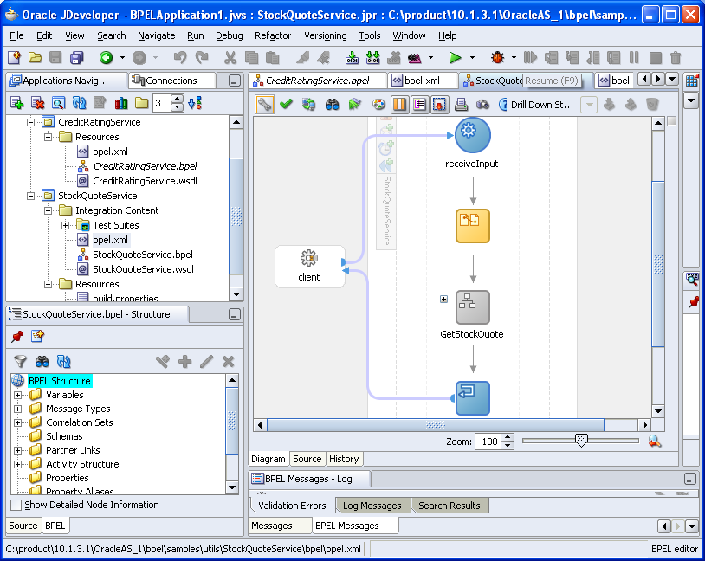
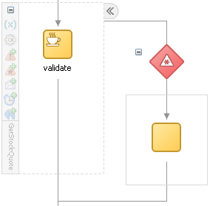
Oracle SOA Suite: StockQuoteService
BPEL composition with WSDL interface

Slide 27
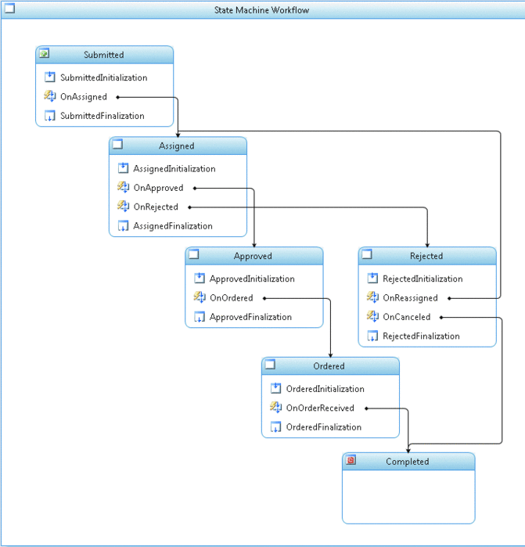
Microsoft Workflow Foundation
Submitted
Assigned
approve
Approved
Rejected
reassign
cancel
Ordered
Completed

Slide 28
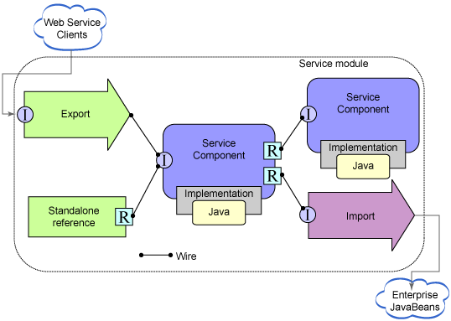
Service Component Architecture (SCA) Service Data Object (SDO)
https://www.ibm.com/support/knowledgecenter/en/SSMKHH_10.0.0/com.ibm.etools.mft.doc/ac68550_.htm

Slide 29
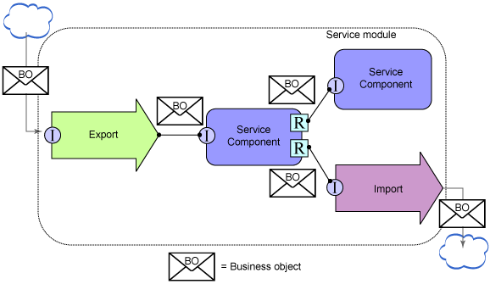
Service Component Architecture (SCA) Service Data Object (SDO)

Slide 30
Integration/Composition

Slide 31
Integration/Composition
How services can interact over the network?
APIs:
Commands- actions, synchronous
Messages- request for information, no state change, synchronous
Events: facts and notifications, asynchronous
Streams: a sequence of events/data elements made available over time

Slide 32
Types
Learn the differences between an event-driven streaming platform like Apache Kafka and middleware like Message Queues (MQ), Extract-Transform-Load (ETL) and Enterprise Service Bus (ESB).
Including best practices and anti-patterns, but also how these concepts and tools complement each other in an enterprise architecture.

Slide 33
Problems of Legacy Middleware
Extract-Transform-Load (ETL) is still a widely-used pattern to move data between different systems via batch processing.
Due to its challenges in today’s world where real time is the new standard, an Enterprise Service Bus (ESB) is used in many enterprises as integration backbone between any kind of microservice, legacy application or cloud service to move data via SOAP / REST Web Services or other technologies.
Stream Processing is often added as its own component in the enterprise architecture for correlation of different events to implement contextual rules and stateful analytics.
Using all these components introduces challenges and complexities in development and operations.

Slide 34
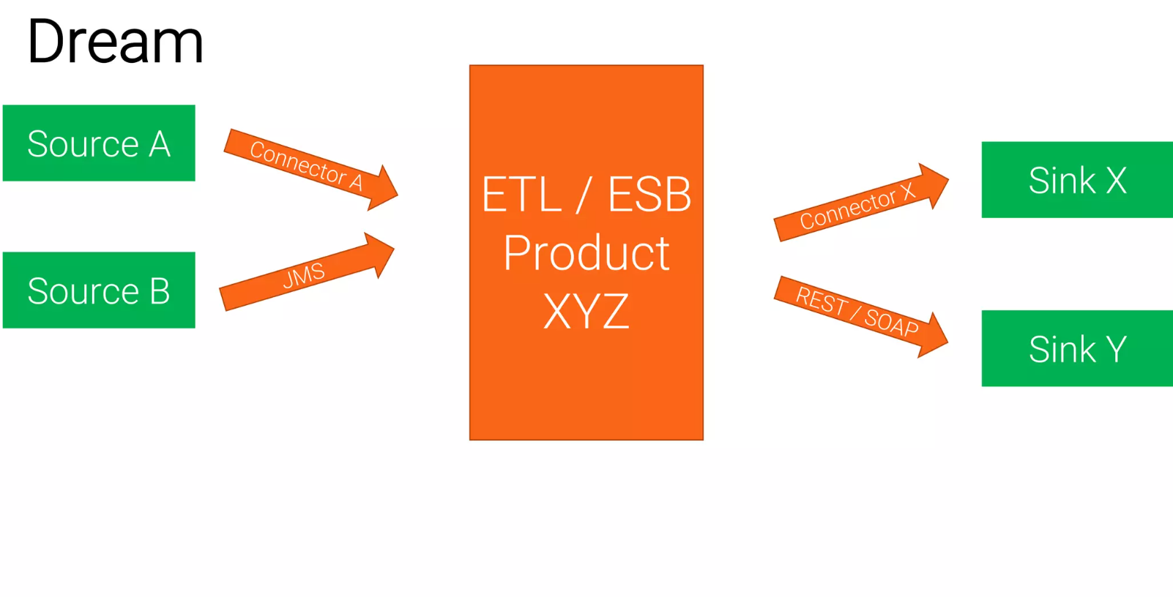
Traditional Middleware

Slide 35
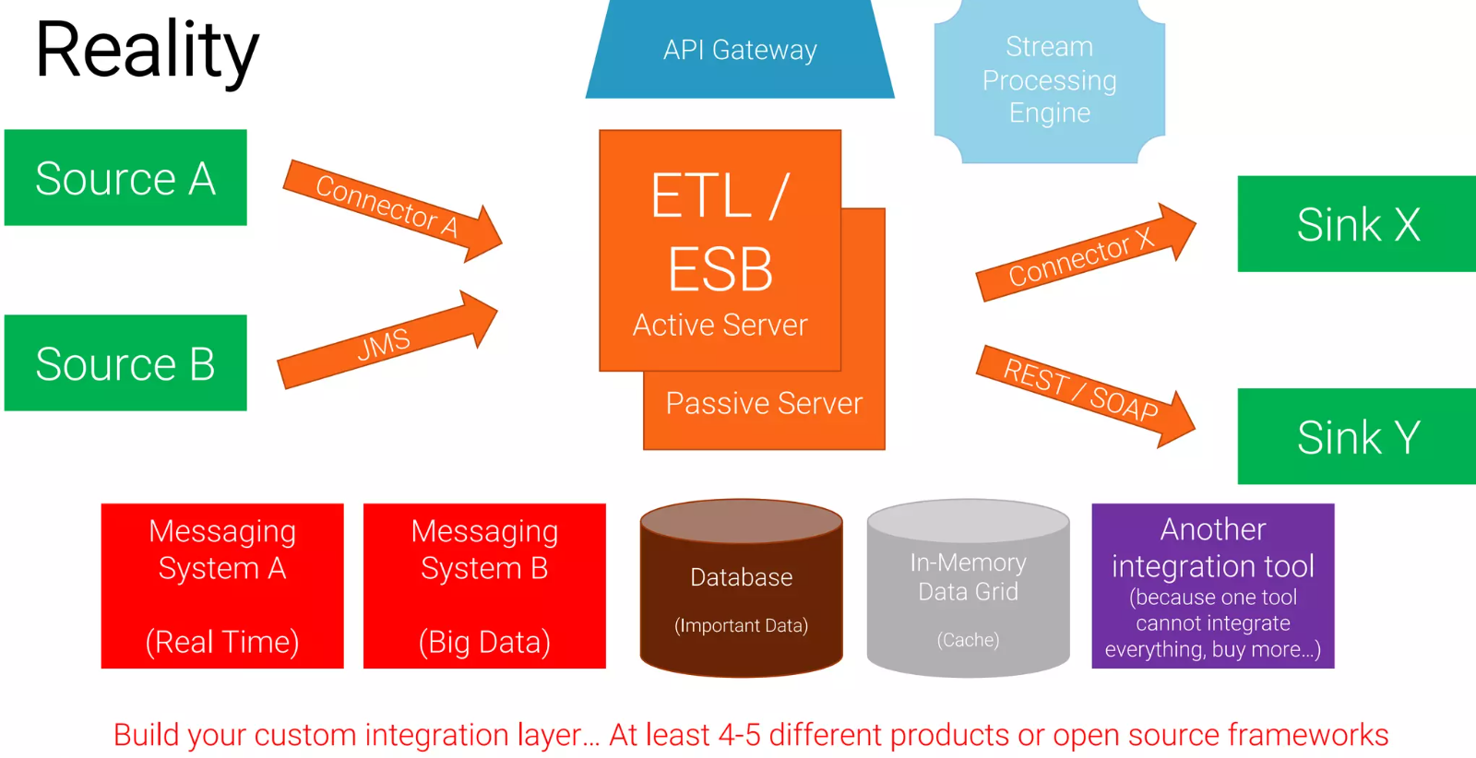
Traditional Middleware

Slide 36
Challenges (MQ, ETL, ESB)
Zoo of technologies
Integration platform (ETL/ESB) + additional optional components
Database
APIs
Architecture with limited scalability and availability
No end-to-end, no native built-in scalability
Downtime for maintenance
Tight Coupling
No separation of concerns and vendor lock-in

Slide 37
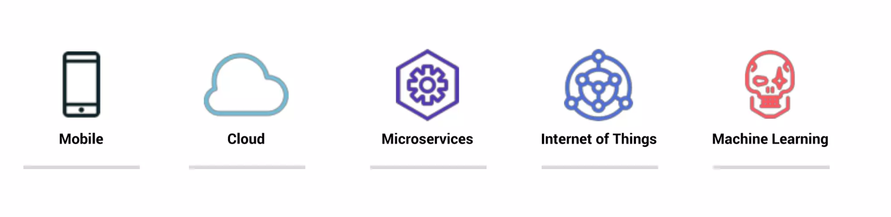
The World Has Changed
Business Digitalization Trends are driving the need to process events at a whole new scale, speed, and efficiency

Slide 38
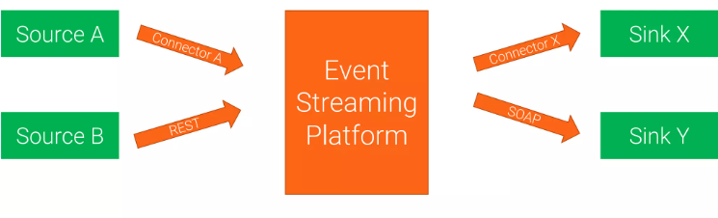
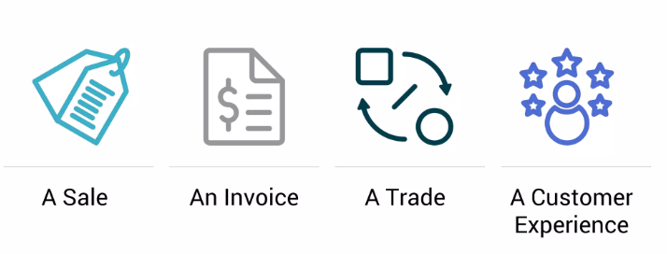
Event Streaming Platforms
Events

Slide 39
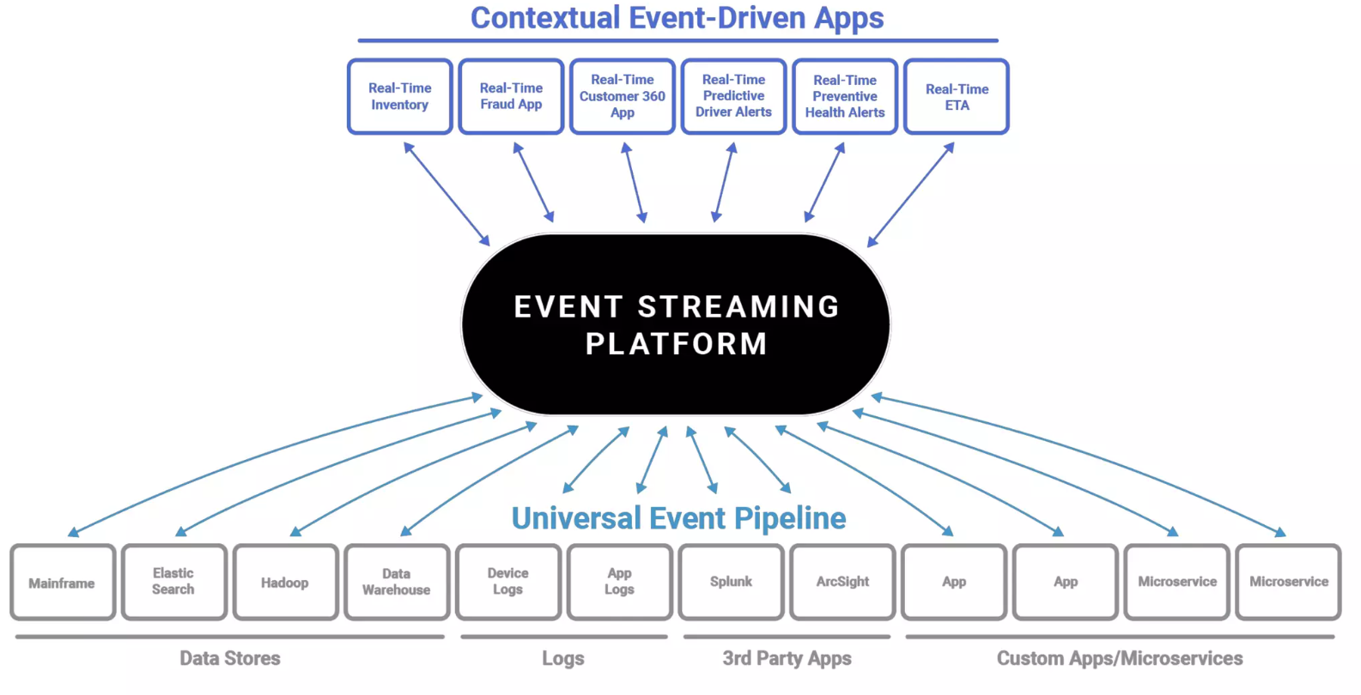

Slide 40
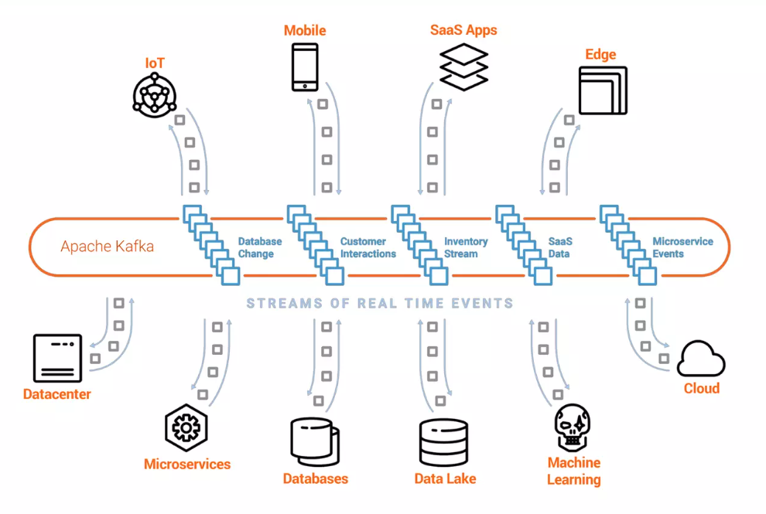
Apache Kafka
Global-scale
Real-time
Persistent Storage
Stream Processing

Slide 41
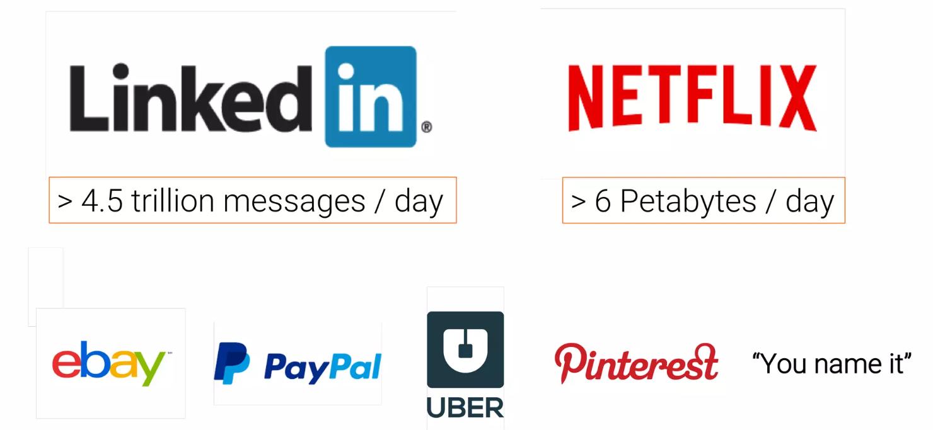
Kafka at Scale

Slide 42
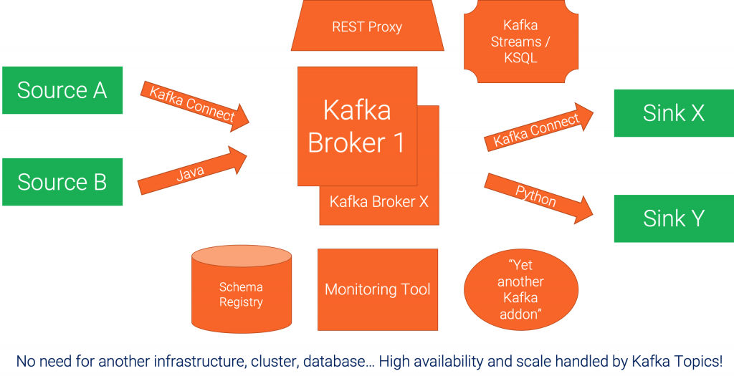
A concrete example architecture

Slide 43
Comparison: Apache Camel vs. Apache Kafka
Should I use Apache Camel or Apache Kafka for my next integration project?
The question is very valid and comes up regularly.
We are going to explore both open-source frameworks and explains the difference between application integration and event streaming.
The comparison discusses when to use Kafka or Camel, when to combine them, when not to use them at all.
A decision tree shows how you can quickly qualify out one for the other.

Slide 44
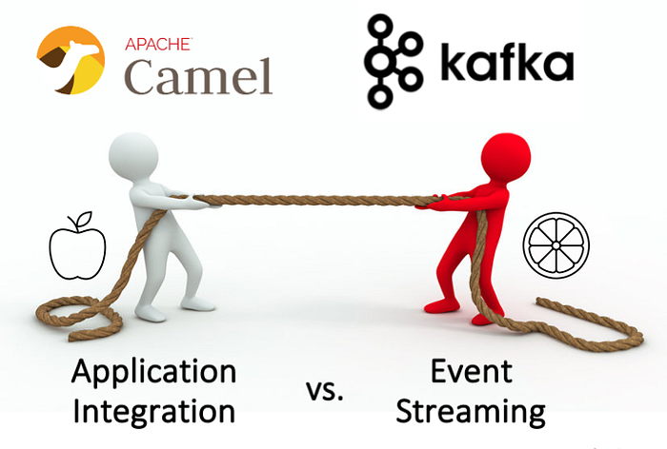

Slide 45
Comparison
Application integration (= Camel) and event streaming (= Kafka) play a critical role in every modern enterprise architecture.
Open-source is widely adopted and usually preferred compared to proprietary solutions for various reasons, including avoiding vendor lock-in.
That’s true for self-managed and serverless cloud offerings.

Slide 46
Comparison
Hence, the question arises: Should I use Apache Camel for application integration or Apache Kafka for event streaming? Or both? Or does one solve the other, too?
These questions will be answered in the following sections, concluding with a decision tree to help you make the right choice for your project.
Let’s look at the similarities between Camel and Kafka, when to use which framework, when and how to combine them, and when not to use them at all.

Slide 47
Features in Apache Camel AND Apache Kafka
Open source under Apache 2.0 license
Vibrant community and adoption in the industry
Mature framework with deployments in enterprises across the globe
Fixing point-to-point spaghetti architectures with a central integration backbone
Open architecture and extensibility with custom functions and connectors
Small and big deployments possible, plus single-node deployments for non-mission-critical use cases
Re-engineered and optimized for cloud-native deployments (container, Kubernetes, cloud)
Connectivity to any technology, API, communication paradigm, and SaaS
Transformation of any data types and formats
Processes transactional and analytical workloads
Domain-specific language (DSL) for message at a time processing, with similar logic such as aggregation, filtering, conditional processing
Relative complex frameworks because of their robust feature set, hence not suitable for solving a minor problem
Not a replacement of a database, data warehouse, or data lake

Slide 48
Features in Apache Camel AND Apache Kafka
Beyond the similarities, Kafka and Camel have very different sweet spots built to solve distinct problems.
Hence, comparing these two tools is a bit comparison of apples and oranges.
Some minor projects might use one or the other to solve the problem, but critical enterprise projects show the differences more quickly.

Slide 49
When to use Apache Camel?
The mission of Camel
Apache Camel is an integration framework.
It solves a particular problem: Data integration between different applications, APIs, protocols, and communication paradigms.
This concept is often called application integration or enterprise integration.
Camel implements the famous Enterprise Integration Patterns (EIP).
EIPs are based on messaging principles.

Slide 50
Camel’s strengths
Event-based backbone based on well-known and adopted EIP concepts
Connectivity to almost any API
Integration, processing, and routing of information with an intuitive domain-specific language (DSL) with a focus on integration; providing the ability of composability in a programming context for finer grain control in code for doing conditional logic or transformations/reformatting
Powerful routing capabilities with many built-in EIPs
Many deployment options (standalone, web container, application server, Spring, OSGi, Kubernetes via the Camel K sub-project) — okay, I guess some options are not relevant in this decade anymore :-)
Lightweight alternative to proprietary ETL and ESB tools

Slide 51
Camel’s weaknesses
Only a “routing machine”, i.e., not built for long-term storage (additional cache or storage needed), for that reason, Camel is not the right choice for a central nervous system like Kafka
No stream processing (like you know it from Kafka Streams or Apache Flink)
Limited scalability, not built for massive volumes of data
No powerful visual coding like you know it from proprietary ETL/ESB/iPaaS tools
No serverless cloud offering, with that also not competing with other iPaaS offerings
Red Hat is the only vendor supporting it
Built to be deployed in a single data center or cloud region, not across hybrid or multi-cloud scenarios

Slide 52
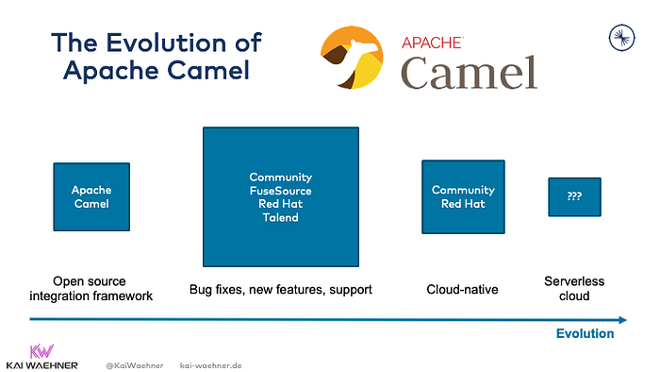
The evolution of Apache Camel

Slide 53
Camel TL;DR
Camel is an application integration framework to connect different applications and interfaces.
Camel is NOT built for processing data in motion continuously, i.e., stream processing.
Hence, it should be compared to ETL and ESB tools, not data streaming technologies like Kafka, Kinesis, or Flink.
If you look for a serverless cloud offering, you are out of luck.
If you look for vendor support, Red Hat is the only option.

Slide 54
When to use Apache Kafka?
The mission of Kafka
Real-time data beats slow data at any scale.
The event streaming platform enables processing data in motion.
Kafka is the de facto standard for event streaming, including messaging, data integration, stream processing, and storage.
Kafka provides all capabilities in one infrastructure at scale.
It is reliable and allows to process analytics and transactional workloads.

Slide 55
Kafka’s strengths
Event-based streaming platform
A unique combination of pub/sub messaging, data processing, data integration, and storage in a single framework
Built for massive volumes of data and extreme scale from the beginning, with that a single framework can be used for transactional (low volume) and analytics (high volume) use cases
True decoupling between producers and consumers because of its storage component makes it the de facto standard for microservice architectures
Guaranteed ordering of events in the distributed commit log
Distributed data processing with fault-tolerance and recoverability built-in
Replayability of events
The de facto standard for event streaming
Built with hybrid and multi-cloud data replication in mind (with included tools like MirrorMaker and separate, more advanced, and more straightforward tools like Confluent Cluster Linking)
Support from many vendors, including Confluent, Cloudera, IBM, Red Hat, Amazon, Microsoft, and many more
Paradigm shift: Built to process data in motion end-to-end from source to one or more sinks

Slide 56
Kafka’s weaknesses
Paradigm shift: Enterprises need to learn and understand the added value of event streaming, a new software category that enables new use cases but also requires different design patterns and operations approaches
No powerful visual coding like you know it from proprietary ETL/ESB/iPaaS tools
Limited out-of-the-box routing capabilities (Kafka Connect SMT or Kafka Streams / ksqlDB app do the job very well, but not as simple as Camel)
Complex operations (if you run it by yourself instead of using 3rd party tools or even better a serverless cloud offering)

Slide 57
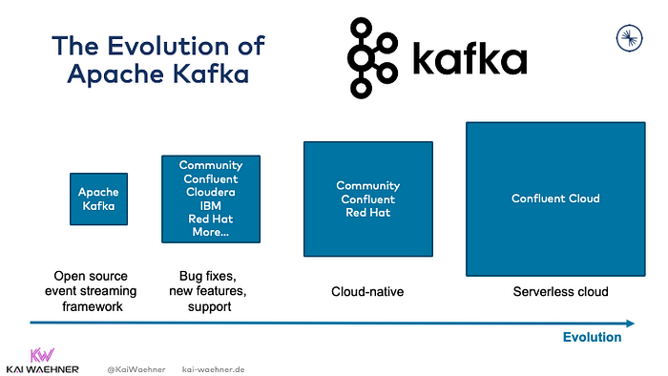
The evolution of Apache Kafka

Slide 58
Kafka TL;DR
Kafka is an event streaming platform to process data in motion continuously.
If you “just” need an integration framework to route data from a source to one or more sinks (= ETL / ESB), then Camel can be used, too.
However, Kafka kills two birds with one stone (= integrating data AND processing it in motion where needed).
Plenty of Kafka offerings are available on the market.
Check out the Apache Kafka landscape and comparison to understand the differences between offerings from Confluent, Cloudera, IBM, Red Hat, Amazon, Microsoft, and others.

Slide 59
Decision tree — Camel or Kafka?
Both frameworks overlap with their capabilities
Qualify out, Do you need:
Big data processing?
A storage component for true decoupling and replayability of events?
Stateless or stateful stream processing?
A serverless cloud offering?
Qualifying out solutions because of their limitations makes the decision tree and evaluation process much easier from the beginning.

Slide 60
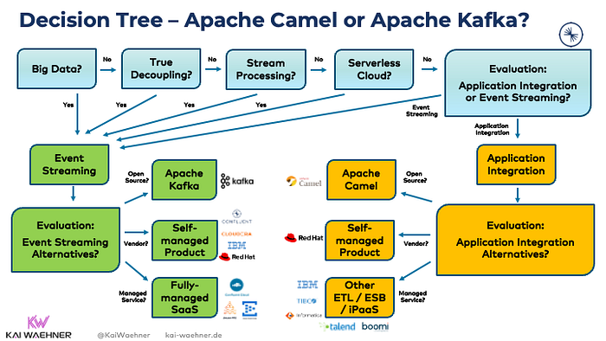
Decision tree — Camel or Kafka?

Slide 61
When to use Camel and Kafka together?
It is possible to use Camel and Kafka together in a single integration architecture.
Should you do that? Two options exist. One makes more sense than the other:
Kafka for event streaming and Camel for ETL

Slide 62
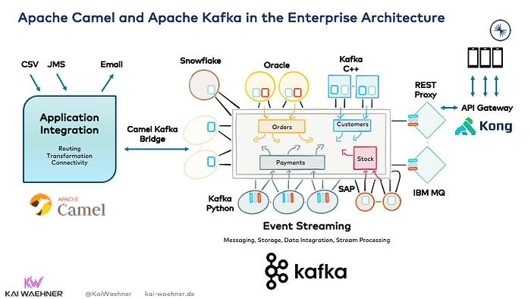

Slide 63
When to use Camel and Kafka together?
Once again, the vast advantage of Kafka as central integration layer is its unique combination of characteristics within a single infrastructure, including:
Real-time messaging at any scale
Storage for true decoupling between different applications and communication paradigms
Built-in backpressure handling and replayability of events
Data integration
Stream processing

Slide 64
When NOT to use Camel or Kafka at all?
Both Camel and Kafka are NOT built for the following scenarios:
A proxy for millions of clients (like mobile apps) — but native proxies (like a REST or MQTT Proxy for Kafka) exist for some use cases.
An API Management platform — but these tools are usually complementary and used to create life cycle management or monetize APIs deployed with Camel or Kafka.
A database for complex queries and batch analytics workloads
an IoT platform with features such as device management — but direct native integration with (some) IoT protocols such as MQTT or OPC-UA is possible and the approach for (some) use cases.
A technology for hard real-time applications such as safety-critical or deterministic systems — but that’s true for any other IT framework, too. Embedded systems are a different software than Camel or Kafka!

